Slide 1
Network Devices

Slide 2
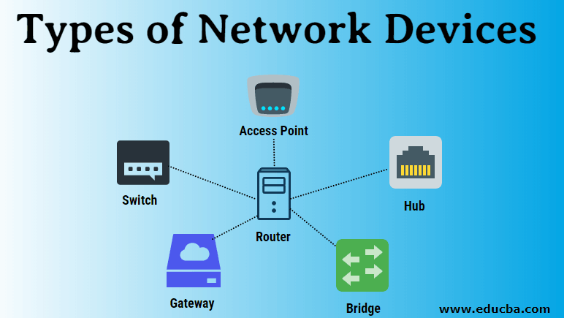

Slide 3
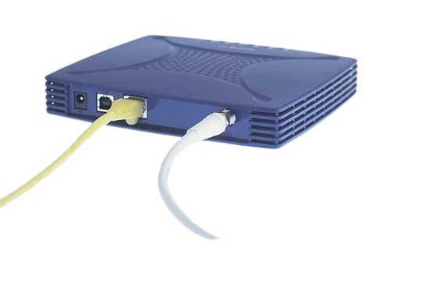
Modem
A modulator-demodulator or modem is a computer hardware device that converts data from a digital format into a format suitable for an analog transmission medium such as telephone or radio. A modem transmits data by modulating one or more carrier wave signals to encode digital information, while the receiver demodulates the signal to recreate the original digital information. The goal is to produce a signal that can be transmitted easily and decoded reliably. Modems can be used with almost any means of transmitting analog signals, from light-emitting diodes to radio.

Slide 4
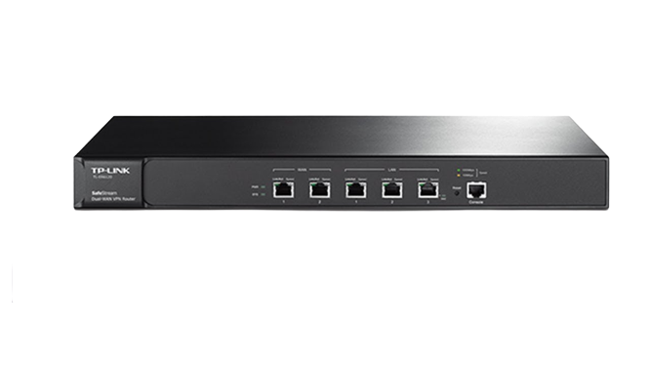
Router
A router is a device that connects two or more packet-switched networks or subnetworks. It serves two primary functions: managing traffic between these networks by forwarding data packets to their intended IP addresses, and allowing multiple devices to use the same Internet connection.

Slide 5
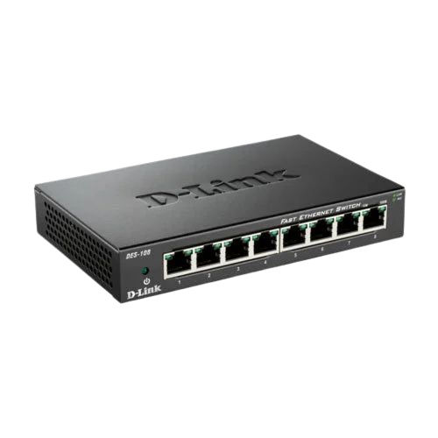
Network HUB
A hub is a common connection point, also known as a network hub, which is used for connection of devices in a network. It works as a central connection for all the devices that are connected through a hub. The hub has numerous ports. If a packet reaches at one port, it is able to see by all the segments of the network due to a packet is copied to the other ports. A network hub has no routing tables or intelligence (unlike a network switch or router), which is used to send information and broadcast all network data across each and every connection

Slide 6
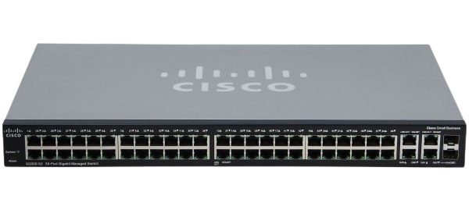
A network switch (also called switching hub, bridging hub, and, by the IEEE, MAC bridge[1]) is networking hardware that connects devices on a computer network by using packet switching to receive and forward data to the destination device.
A network switch is a multiport network bridge that uses MAC addresses to forward data at the data link layer (layer 2) of the OSI model. Some switches can also forward data at the network layer (layer 3) by additionally incorporating routing functionality. Such switches are commonly known as layer-3 switches or multilayer switches.[2]

